Slide 1
Run Away If You Can:
Persistent Jamming Attack Against
Channel Hopping Wi-Fi Devices In a Dense Network
Research in Attacks, Intrusions, and Defenses (RAID), 2014
Il-Gu Lee, and Myungchul Kim
Graduate School of Information Security, KAIST
Slide <number>
Notes:
doc.: IEEE 802.11-yy/xxxxr0
Il-Gu Lee, ETRI
Page <number>

Slide 2
Contents
1
Introduction
2
Related Work
3
Proposed Attack
4
Evaluation
5
5
Defense
6
Conclusion
Slide <number>
Notes:
doc.: IEEE 802.11-yy/xxxxr0
Il-Gu Lee, ETRI
Page <number>

Slide 3
Introduction
In this research,
  First show reactive jamming is not effective in a dense network.
  Investigate the security limitations on physical layer header.
  Show that persistent jamming is feasible in a dense network.
  Recommend security remedies against persistent jamming.
Our contributions:
  Propose a new jamming attack called “persistent jamming”.
  Demonstrate the feasibility with experiment and emulation.
Slide <number>
Notes:
doc.: IEEE 802.11-yy/xxxxr0
Il-Gu Lee, ETRI
Page <number>

Slide 4
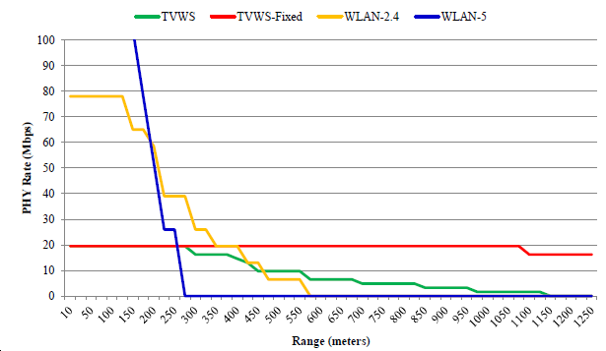
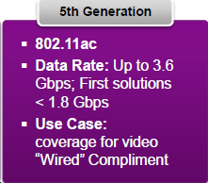
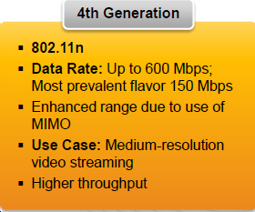
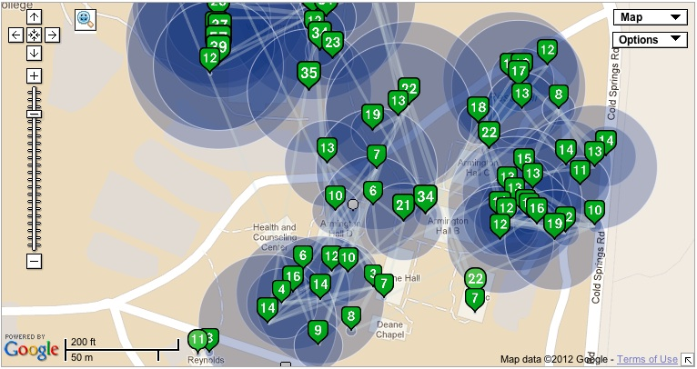
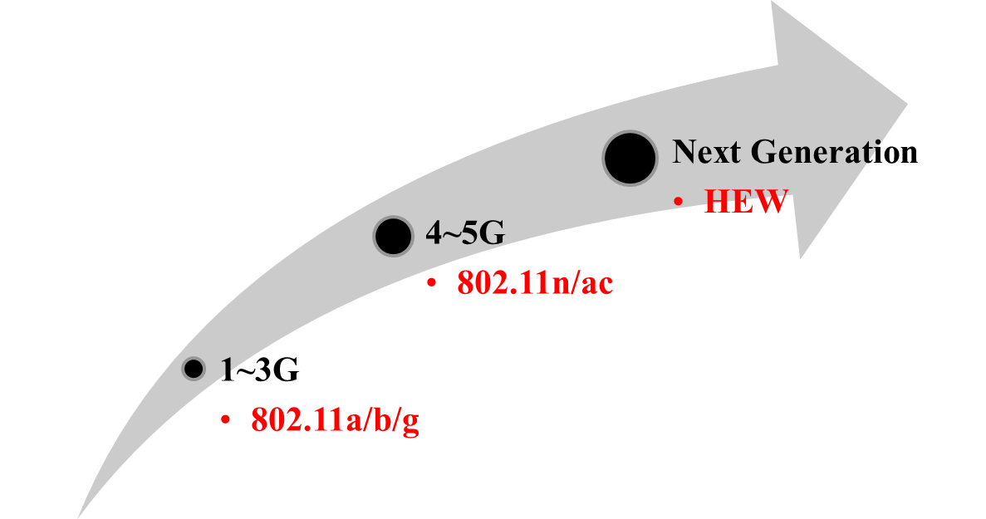
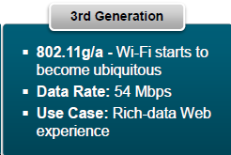
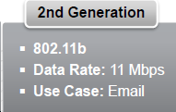
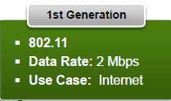
Evolving Wi-Fi
Denser
Network
Wider Bandwidth
Local Area Network
(2.4 & 5GHz)
<2012>
<2007>
<2002>
Longer
Coverage
<1999>
Wide Area Network
(Sub 1GHz)
Super Wi-Fi
802.11ah/af
<1997>
Reference: [5-10]
Slide <number>
Notes:
doc.: IEEE 802.11-yy/xxxxr0
Il-Gu Lee, ETRI
Page <number>

Slide 5
Related Work (1/2)
Conventional jamming [1-4]
  Limitations
    Channel hopping devices can avoid the proactive jamming.
    Reactive jamming is not effective in a dense network.
Category | Proactive |  |  | Reactive
 | Constant | Random | Deceptive
Complexity | Very simple |  | Simple
Jamming effect | Bad |  | Nod bad | Good?
Power efficiency | Too bad | Bad |  | Good?
Detection probability | High |  | Med | Low
Slide <number>
Notes:
doc.: IEEE 802.11-yy/xxxxr0
Il-Gu Lee, ETRI
Page <number>

Slide 6
Related Work (2/2)
Channel hopping [13-16]
  802.11 dynamic frequency selection (DFS)
    Reactive channel hopping between AP and STAs.
Category | Active type |  | Passive type
Subtype | Proactive | Reactive | Firmware | Manual
Hopping method | Predefined hopping sequence | Error statistics | Disconnection
Applications | Bluetooth, etc. | Wi-Fi, etc.
Speed | Fast | Slow | Very slow
Deployment | Not used in Wi-Fi due to inefficiency and complexity | Typical | Few devices | Typical
Slide <number>

Slide 7
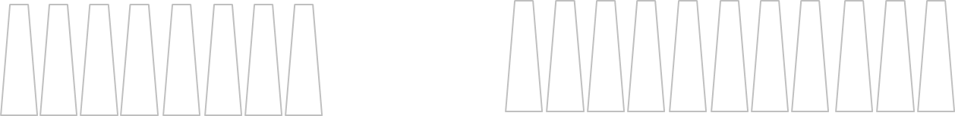
Motivation (1/2)
  T: Target node
  J: Reactive jammer
In existing reactive jamming scenarios,
But, in real world, the reactive jamming is not effective
36
40
44
48
52
56
60
64
100
104
108
112
116
120
124
128
132
136
140
J
J
T
T
5150
5250
5350
5470
5570
5670
5725 [MHz]
Which channel?
36
40
44
48
52
56
60
64
100
104
108
112
116
120
124
128
132
136
140
J
T
T
T
5150
5250
5350
5470
5570
5670
5725 [MHz]
Slide <number>
Notes:
doc.: IEEE 802.11-yy/xxxxr0
Il-Gu Lee, ETRI
Page <number>

Slide 8
Motivation (2/2)
In a dense network,
  Reactive jamming is not effective.
    Cannot identify channel-hopping devices.
    Just emit jamming signal to busy channels.
  Proposed jamming attack:
    Persistent jamming, a modified reactive jamming.
    Track a specific target node, and jam the target device or a target group of devices.
  T: Target node
  J: Persistent jammer
Track “Green one”, and jam
36
40
44
48
52
56
60
64
100
104
108
112
116
120
124
128
132
136
140
J
T
T
T
5150
5250
5350
5470
5570
5670
5725 [MHz]
Slide <number>
Notes:
doc.: IEEE 802.11-yy/xxxxr0
Il-Gu Lee, ETRI
Page <number>

Slide 9
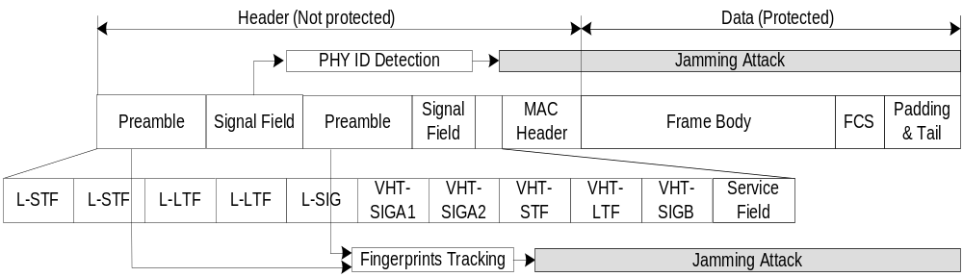
Persistent Jamming Attack
< IEEE 802.11ac frame structure [6] and persistent jamming attack >
Slide <number>

Slide 10
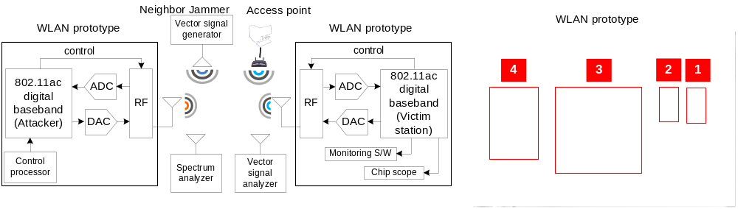
Experimental setup (1/2)
< IEEE 802.11n/ac prototype system >
Slide <number>

Slide 11
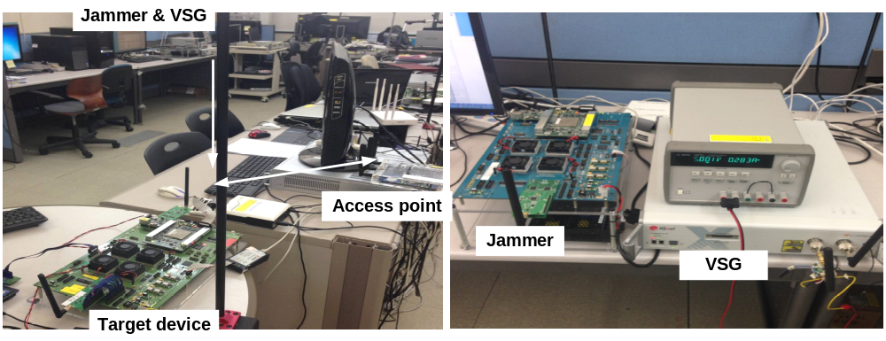
Experimental setup (2/2)
< Experimental set-up: (a) overall test configuration (left), (b) jammer (right) >
Slide <number>
Notes:
doc.: IEEE 802.11-yy/xxxxr0
Il-Gu Lee, ETRI
Page <number>

Slide 12
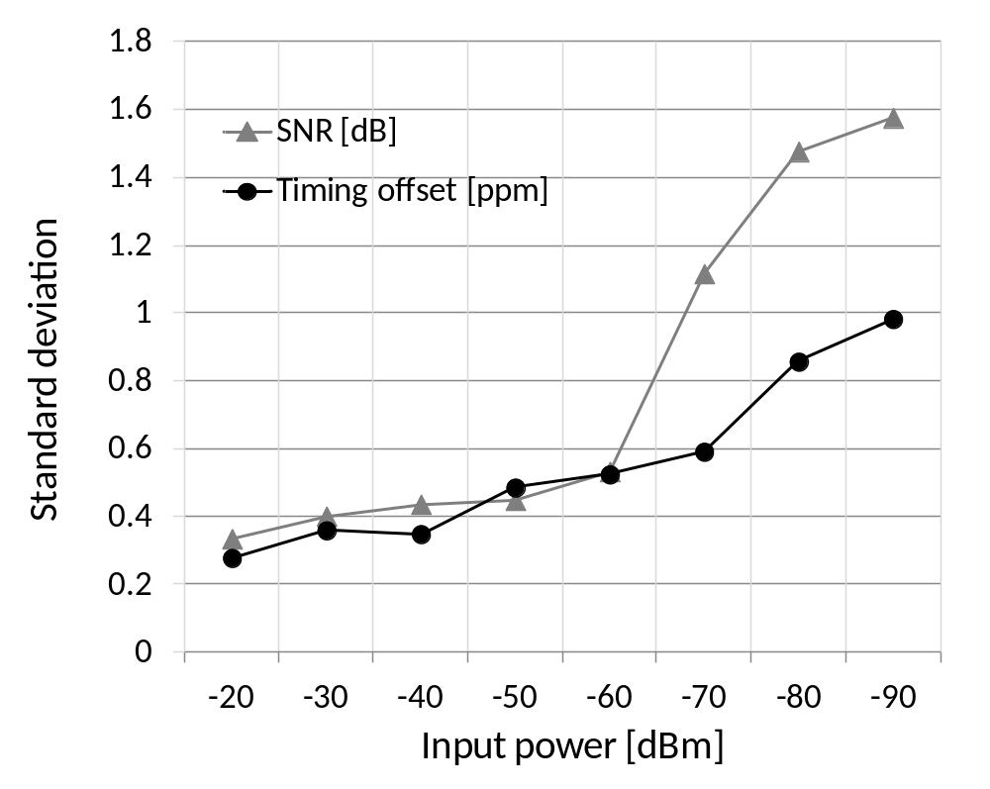
Experimental Results (1/3)
< Wired test: Standard deviation of device fingerprints >
Slide <number>

Slide 13
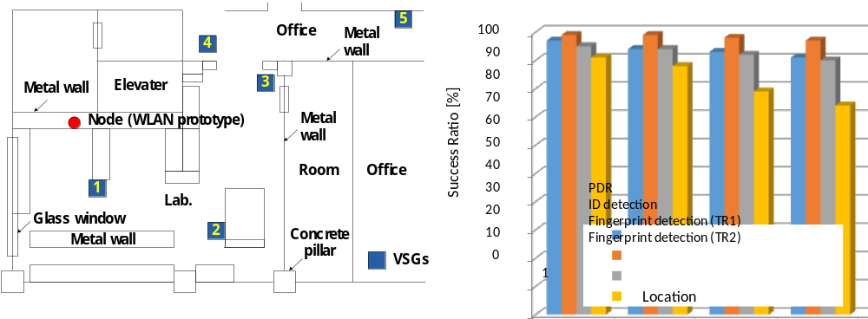
Experimental Results (2/3)
< Wireless test: Wireless measurement condition (left), and detection success ratio vs.
location (right) >
Slide <number>
Notes:
doc.: IEEE 802.11-yy/xxxxr0
Il-Gu Lee, ETRI
Page <number>

Slide 14
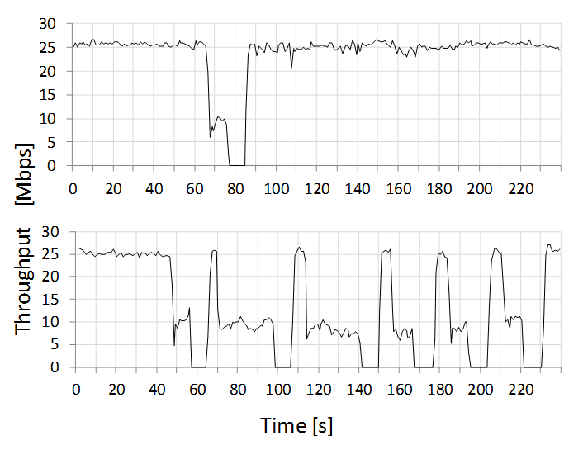
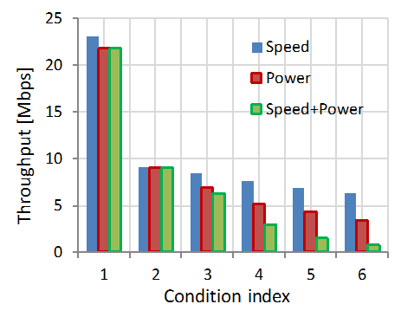
Experimental Results (3/3)
Condition index | Jamming type | R_{T} | T_{P} | R_{T} + T_{P}
1 | Reactive | (0.125,0) | (2,20) | (0.125,20)
2 | Persistent | (2,0) | (2,0) | (2,0)
3 |  | (1,0) | (2,5) | (1,5)
4 |  | (0.5,0) | (2,10) | (0.5,10)
5 |  | (0.25,0) | (2,15) | (0.25,15)
6 |  | (0.125,0) | (2,20) | (0.125,20)
< Throughput measurement at target node for different jamming attack:
reactive jammer (upper), and persistent jammer (lower),
Jamming efficacy by different jamming speed and transmission power>
Slide <number>

Slide 15
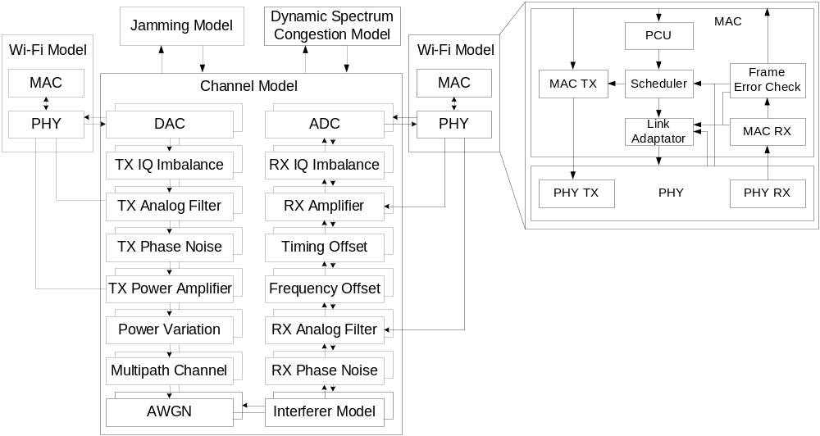
Large Scale Emulation Setup
< Emulation environment, channel model, and MAC model >
Slide <number>

Slide 16
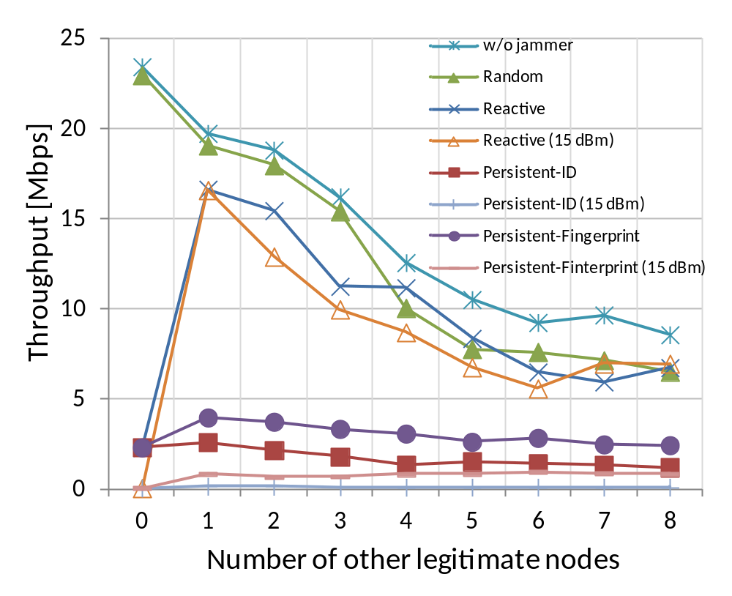
Large Scale Emulation Results
< Jamming efficacy: throughput vs. number of neighbor legitimate nodes >
Slide <number>

Slide 17
Defenses (1/2)
ID protection
  Non-cryptographic device authentication
    Cryptographic? High complexity and overhead
    ID encoding using channel reciprocity property [25].
    Main drawback: i) stationary condition, ii) calibration using additional circuits and protocol.
  Dynamic ID allocation
    Static ID allocation in current system.
    Periodically update ID using time synchronization function.
    Main drawback: i) can still intercept ID during the same ID period, ii) reduced update interval increases overhead.
[25] Xiao Liang, L. Greenstein, N. Mandayam, and W. Trappe, “Using the physical layer for wireless authentication in time-variant channels, ” IEEE Trans. On Wireless Communications, Vol. 7, No. 7, pp. 2571-2579, Jul. 2008.
Slide <number>

Slide 18
Defenses (2/2)
Fingerprints protection
  Digital predistortion
    Standard define impairments tolerance levels at a receiver.
    Predistorted signals by a random offset for every packet which can be compensated at a receiver.
    Main drawback: Residual error during estimation and compensation due to the finite hardware resolution
  Friendly jamming
    [26]: friendly jamming cannot provide strong confidentiallity.
    It is only true for simple modulation system in narrow bandwidth and low radio frequency.
    Main drawback: i)Tradeoff between security level and receiving performance, ii) additional hardware resources
[26] N.O. Tippenhauer, L. Malisa, A. Ranganathan, and S. Capkun, “On Limitations of Friendly Jamming for Confidentiality, ” IEEE S&P, pp. 160-173, May. 2013.
Slide <number>

Slide 19
Conclusion
First work on persistent jamming.
  Jamming attack against channel-hopping devices.
  Tracking and jamming based on ID and fingerprints using PHY header.
  Significantly degraded throughput and shut down communication link.
Demonstrate the feasibility in real-world prototype and large-scale emulation.
  Tracking success ratio of device using ID and fingerprint.
  Experimentally demonstrated persistent jamming is feasible.
  Prototype and emulation model have been developed.
Security remedies
  ID: Non-cryptographic device authentication, dynamic ID allocation.
  Fingerprints: Digital predistortion, friendly jamming.
Slide <number>
Notes:
doc.: IEEE 802.11-yy/xxxxr0
Il-Gu Lee, ETRI
Page <number>

Slide 20
Reference (1/2)
[1] Matthias Wilhelm, Ivan Martinovic, Jens B. Schmitt, and Vincent Lenders, “Reactive jamming in wireless networks: how realistic is the threat?,” Proceedings of the fourth ACM conference on WiSec, pp.47-52, 2011.
[2] Yingying Chen, Wenyuan Xu, Wade Trappe, and Yan Yong Zhang, “Securing Emerging Wireless Systems Lower-Layer Approaches,” Springer, New York, 2009.
[3] Wenyuan Xu, Wade Trappe, and Yanyong Zhang,”Channel Surfing: Defending Wireless Sensor Networks from Interference,” ACM IPSN, pp.499-508, 2007.
[4] Wenyuan Xu, Wade Trappe, Yanyong Zhang, and Timothy Wood, “The Feasibility of Launching and Detecting Jamming Attacks in Wireless Networks,” ACM MobiHoc, pp.46-57, 2005.
[5] IEEE Standard 802.11n, 2009.
[6] IEEE P802.11ac, Draft 7.0, Sep. 2013.
[7] IEEE P802.11af, Draft 4.0, Apr. 2013.
[8] IEEE P802.11ah, Draft 1.0, May. 2013.
[9] Greg Goth, “Next-Generation Wi-Fi: As Fast as We'll Need?,” IEEE Internet Computing, Vol. 16, No. 6, pp. 7-9, Nov. 2012.
[10] Laurent Carious, et al., “High-efficiency WLAN, ” IEEE 802.11-13/0331r5, Mar. 2013.
[11] Ilkka Harjula, Jarno Pinola, and Jarmo Prokkola, “Performance of IEEE 802.11 based WLAN Devices Under Various Jamming Signals,” IEEE MILCOM, pp. 2129-2135, Nov. 2011.
[12] Abderrahim Benslimane, and Abdelouahid El Yakoubi, and Mohammed Bouhorma, “Analysis of Jamming Effects on IEEE 802.11 Wireless Noetworks,” IEEE ICC, pp. 1-5, Jun. 2011.
[13] N. Golmie, O. Rebala, and N. Chevrolier, “Bluetooth adaptive frequency hopping and scheduling, ” IEEE MILCOM, pp. 1138-1142, Oct. 2013.
[14] IEEE Standard 802.11h, 2003.
[15] Vishnu Navda, Aniruddha Bohra, Samrat Ganguly, and Dan Rubenstein, “Using Channel Hopping to Increase 802.11 Resilience to Jamming Attacks,” IEEE INFOCOM, pp. 2526-2530, May 2007.
[16] Ramakrishna Gummadi, David Wetherall, Ben Greenstein, and Srinivasan Seshan, “Understanding and Mitigating the Impact of RF Interference on 802.11 Networks,” ACM SIGCOMM, pp. 385-396, Oct. 2007.
[17] Jaemin Jeung, Seungmyeong Jeong, and Jaesung Lim, “Adaptive Rapid Channel-hopping Scheme Mitigating Smart Jammer Attacks in Secure WLAN,” IEEE MILCOM, pp. 1231-1236, Nov. 2011.
[18] Arafet Ben Makhlouf and Mounir Hamdi, “Practical Rate Adaptation for Very High Throughput WLANs,” IEEE Transaction on Wireless Communications, Vol. 2, No. 2, pp. 908-916, Feb. 2013.
Slide <number>

Slide 21
Reference (2/2)
[19] Jiansong Zhang, Kun Tan, Jun Zhao, Haitao Wu, and Yongguang Zhang, “A Practical SNR-Guided Rate Adaptation,” IEEE INFOCOM, pp. 2083-2091, Apr. 2008.
[20] Konstantinos Pelechrinis, Ioannis Broustis, Skikanth V. Krishnamurthy, and Christos Gkantsidis, “A Measurement-Driven Anti-Jamming System for 802.11 Networks,” IEEE/ACM Transaction on Networking, Vol. 19, No. 4, pp. 1208-1222, Aug. 2011.
[21] Cisco Wireless LAN Controller Configuration Guide, Release 7.0, www.cisco.com/c/en/us/td/docs/wireless/controller/7-0/configuration/guide/c70.html.
[22] Shih-Hau Fang, Tsung-Nan Lin, and Kun-Chou Lee, “A Novel Algorithm for Multipath Fingerprinting in Indoor WLAN Environments,” IEEE Transaction on Wireless Communications, Vol. 7, No. 9, pp. 3579-3588, Sept. 2008.
[23] Shih-Hau Fang, Ying-Tso Hsu, and Wen-Hsing Kuo, “Dynamic Fingerprinting Combination for Improved Mobile Localization,” IEEE Transaction on Wireless Communications, Vol. 10, No. 12, pp. 4018-4022, Oct. 2011.
[24] Mu Zhou, Zengshan Tian, Xiang Yu, Xiaomou Tang, and Xia Hong, “A Two-Stage Fingerprint Filtering Approach for Wi-Fi RSS-Based location Matching,” Journal of Computers, No. 9, Vol. 8, pp. 2374-2381, Sep. 2013.
[25] Xiao Liang, L. Greenstein, N. Mandayam, and W. Trappe, “Using the physical layer for wireless authentication in time-variant channels, ” IEEE Trans. On Wireless Communications, Vol. 7, No. 7, pp. 2571-2579, Jul. 2008.
[26] N.O. Tippenhauer, L. Malisa, A. Ranganathan, and S. Capkun, “On Limitations of Friendly Jamming for Confidentiality, ” IEEE S&P, pp. 160-173, May. 2013.
[27] Fan Yang, Xi Zhang, and Zhong-pei Zhang, “Time-domain preamble-based SNR estimation for OFDM systems in doubly selective channels, ” IEEE MILCOM, pp.1-5, Oct. 2012.
[28] T.L. Jensen, and T. Larsen, “Robust Computation of Error Vector Magnitude for Wireless Standards, ” IEEE Trans. On Communications, Vol. 61, No. 2, pp. 648-657, Feb. 2013.
[29] H.A. Mahmoud, and H. Arslan, “Error vector magnitude to SNR conversion for nondata-aided receivers, ” IEEE Trans. On Wireless Communications, Vol. 8, No. 5, pp. 1536-1276, May. 2009.
[30] Il-Gu Lee, Eunyoung Choi, Sok-kyu Lee, and Taehyun Jeon, “High accuracy and low complexity timing offset estimation for MIMO-OFDM receivers, ” IEEE WCNC, pp. 1439-1443, Apr. 2006.
[40] Rohit V. Gaikwad, “Appratus and method for sampling frequency offset estimation and correction in a wireless communication system, ” US patent, US2007/0002981, Jan. 2007.
Slide <number>

Slide 22
Any question or comment?
Slide <number>

